Slide 1

DATA MINING CS619

Slide 2
Mr. Muhammed Ehtesham
Mrs. Arifa Farhath
Mr. Bhavesh
Mr. Shivam
Mr. Nitish
Mr. Yogesh
GROUP MEMBERS:

Slide 3
Project Title
Impact of Discretization on DecisionTable Classifier Performance in WEKA

Slide 4

Discretization Overview
Converts continuous numeric attributes into discrete intervals
Essential for rule-based classifiers like DecisionTable
Improves interpretability and model performance when inputs are categorical

Slide 5

Purpose of the Study
Evaluate how different discretization methods affect classification accuracy
Use WEKA to apply and compare three methods

Slide 6

Discretization Methods Tested
Unsupervised Discretization: Equal-width binning
01
Supervised Discretization: Class-aware bin boundaries
02
PKIDiscretize: Proportional k-interval / equal-frequency binning
03

Slide 7

Dataset Used
Diabetes.arff dataset
Well-known benchmark dataset for classification tasks

Slide 8

Study Goal
Compare accuracy results across different discretization techniques
Identify which method provides the best improvement for Decision Table classifier

Slide 9

Dataset Description
Diabetes.arff dataset
Total instances: 768
Attributes:
8 numeric predictor variables
1 nominal class attribute (positive / negative diabetes test)
Fully numeric predictors make it ideal for evaluating discretization techniques

Slide 10

Experimental Setup
Tool: WEKA Explorer
Classifier Used: DecisionTable
Evaluation Method: 10-fold cross-validation
Dataset Variants Tested:
Unsupervised Discretized
Supervised Discretized
PKIDiscretized
Each version was evaluated independently to observe its impact on classification accuracy
Original dataset (no discretization)

Slide 11

Results

Slide 12
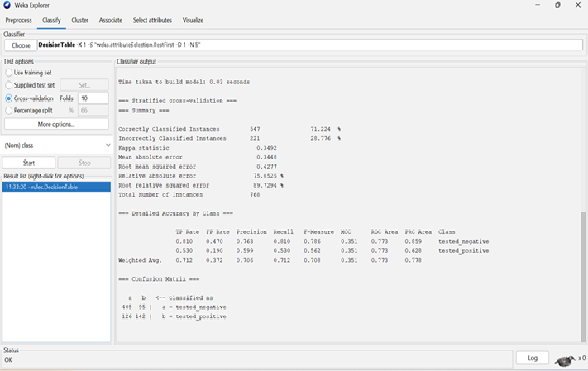
Original diabetes dataset: diabetes.arff

Slide 13
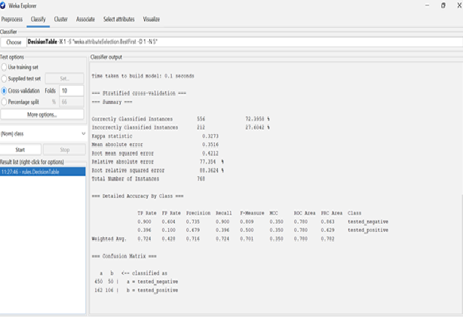
Unsupervised- discretization

Slide 14
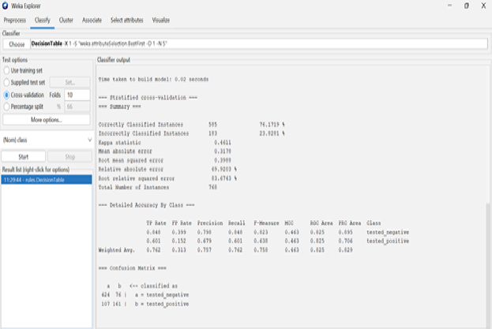
Supervised- discretization

Slide 15
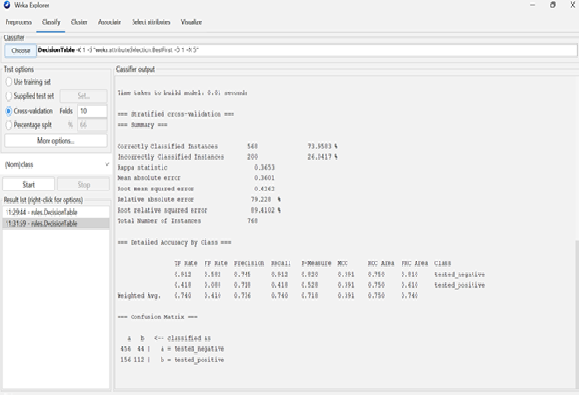
Pk discretization

Slide 16
Accuracy Comparison Table
Dataset Version | Correct | Incorrect | Accuracy (%)
Original dataset | 547 | 221 | 71.22%
Unsupervised Discretize | 556 | 212 | 72.39%
Supervised Discretize | 585 | 183 | 76.17%
PKIDiscretize | 568 | 200 | 73.95%

Slide 17
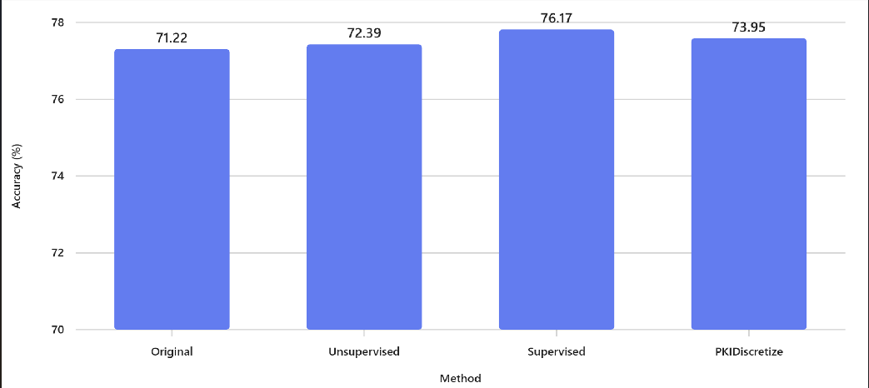
Bar Chart

Slide 18


Interpretation of Results

Slide 19
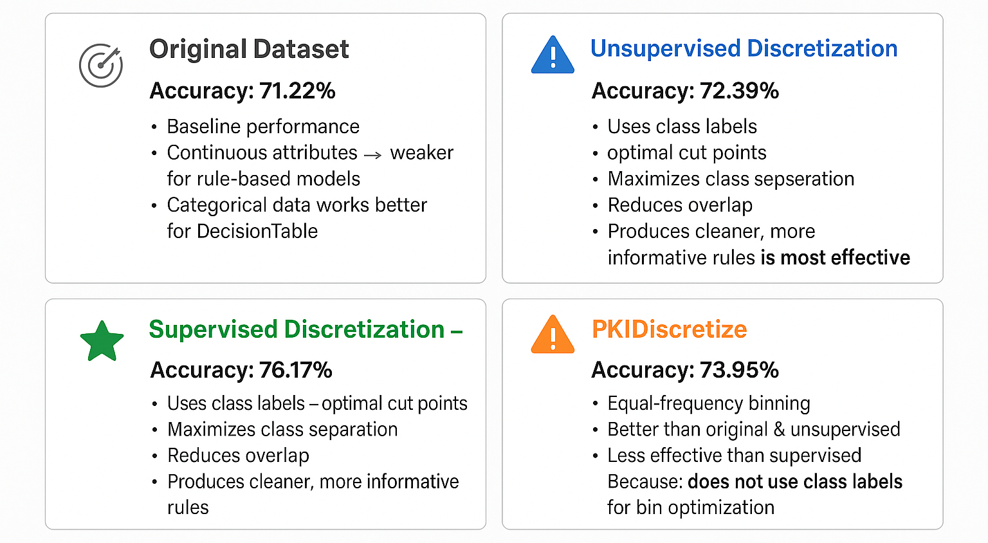

Slide 20
conclusion
Overall, class-informed discretization methods are most effective for rule-based classifiers like Decision Table.
Using discretization — especially supervised — enhances both predictive performance and interpretability of models.

